Slide 1
AI-Driven Explainable Cancer Subtype Prediction (TCGA-BRCA)
Smrithi Radhakrishnan
Data Science /Computational Oncology

Slide 2
Problem statement
Breast cancer is molecularly heterogeneous
PAM50 subtypes drive:
prognosis
therapy selection
Many ML models are black boxes
Clinicians need interpretability + biological grounding

Slide 3
Research objectives
Predict PAM50 subtypes from RNA-seq data
Build an interpretable ML pipeline
Provide biologically grounded explanations
Bridge ML predictions and oncology literature

Slide 4
Pipeline architecture
TCGA-BRCA RNA-seq Data
Preprocessing & Feature Alignment
XGBoost PAM50 Subtype Classifier
Subtype Prediction + Probabilities
Interpretability-Oriented Explanation Layer
(Feature-aware reasoning)
RAG Knowledge Retrieval
(Oncology literature + subtype biology)
LLM Reasoning for Biological Interpretation (Gemma via Ollama)
Agent-Based Explanation Interface (Query Routing & Explanation Logic)
Conversational Explanation Interface (Streamlit Web Interface)

Slide 5
Dataset
Data downloaded from UCSC Xena (TCGA- The Cancer Genome Atlas BRCA – Breast Invasive Carcinoma)
- Gene expression file
- Phenotype file containing patient information like age, tumour subtype and PAM50 subtype column
PAM50 Subtypes (Target column): 'Basal-like', 'HER2-enriched', 'Luminal A', 'Luminal B’, 'Normal-like’

Slide 6
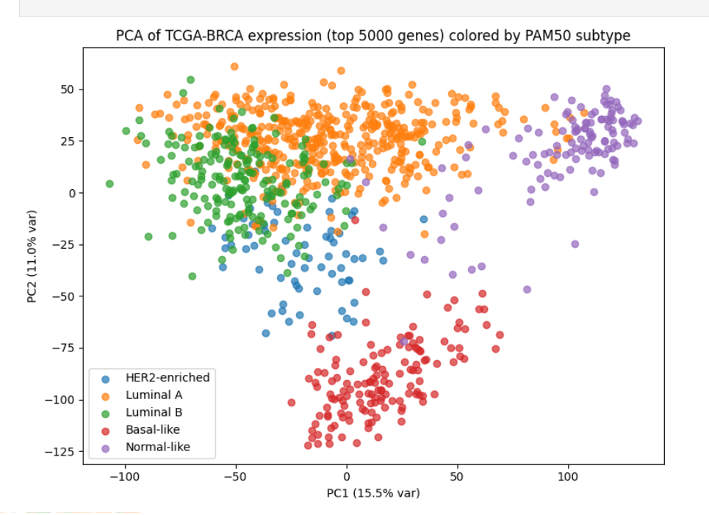
Data preprocessing and integration
Loaded expression and phenotype files
Expression dataset contains gene expressions of patient samples and phenotype dataset contains patient samples, clinical metadata. Transpose of expression dataset was carried out to change the patient samples to row ids
Normalize sample ids – The samples in expression should match with phenotypes dataset. So when we normalize we only retain the samples which are there in both the datasets
Found PAM50 subtype column in phenotype dataset. Renamed the subtypes with full names
Aligned the X(features) and y(labels). Removed missing values and retained only numeric values
Retained the top most variable 5000 genes

Slide 7
Machine Learning model and model performance
Trained the data with XGBoost model
Accuracy: 91%
Overall interpretation: The model achieves high predictive performance while maintaining subtype balance, avoiding dominance by high frequency classes
The XGBoost model achieves high accuracy and biologically meaningful subtype separation, with misclassifications largely confined to known transcriptomic overlaps (Luminal A ↔ Luminal B, HER2 ↔ Luminal B). This supports the model’s suitability for interpretable subtype prediction and downstream biological analysis.
Class-wise interpretation:
Basal like:
Precision: 0.97 | Recall: 1.00 | F1: 0.98
Basal-like tumors are clearly separable at the transcriptomic level, with highly distinctive expression signatures.
No Basal-like samples were missed (perfect recall).

Slide 8
Machine Learning model and model performance
CLASS-WISE INTERPRETATION:
Basal like:
Precision: 0.97 | Recall: 1.00 | F1: 0.98
Basal-like tumors are clearly separable at the transcriptomic level, with highly distinctive expression signatures
No Basal-like samples were missed (perfect recall
HER2-enriched:
Precision: 0.91 | Recall: 0.77 | F1: 0.83
Most predicted HER2-enriched cases are correct (high precision), but some true HER2 tumors are misclassified, often overlapping with Luminal B
Reflects known biological heterogeneity of HER2-positive breast cancer
Trained the data with XGBoost model
Accuracy: 91%
Overall interpretation: The model achieves high predictive performance while maintaining subtype balance, avoiding dominance by high frequency classes
The XGBoost model achieves high accuracy and biologically meaningful subtype separation, with misclassifications largely confined to known transcriptomic overlaps (Luminal A with Luminal B, HER2 with Luminal B). This supports the model’s suitability for interpretable subtype prediction and downstream biological analysis.

Slide 9
Luminal A:
- Precision: 0.88 | Recall: 0.98 | F1: 0.92
- Luminal A tumors are consistently identified, with very few false negatives
- Strong estrogen-related gene expression patterns drive high recall
Luminal B:
- Precision: 0.89 | Recall: 0.79 | F1: 0.84
- Moderate confusion with Luminal A reflects biological continuum between Luminal subtypes, rather than model error alone
Normal-like:
- Precision: 1.00 | Recall: 0.79 | F1: 0.88
- When predicted, Normal-like samples are always correct (perfect precision), but some are misclassified as Luminal A.
- Expected due to lower tumor cellularity and stromal influence.

Slide 10
Validation and Robustness Considerations
Stratified train-test split to preserve subtype balance
Performance consistency across major PAM50 subtypes
Misclassifications align with known biological overlaps (Luminal A with B, HER2 with Luminal B)
Model behavior reflects biology, not random noise

Slide 11
Why XGBoost not deep learning?
High-dimensional, low-sample data
TCGA-BRCA: ~20,000 genes, ~1,000 samples
Tree-based models handle this regime better than deep neural networks without overfitting
Strong performance on tabular omics data
XGBoost consistently outperforms deep models on structured gene expression datasets
Built-in regularization
Shrinkage, tree depth control, column subsampling → reduces noise-driven learning
Interpretability-compatible by design
Enables feature attribution and downstream biological interpretation

Slide 12
Why Explainability Matters?
In oncology, models must answer “why”, not just “what”. Explainability is essential because:
- Clinical trust: Predictions without reasoning cannot be translated to biological or clinical insight
- Biological validation: Identifying subtype-driving genes allows cross-checking with known cancer biology
- Biomarker discovery: Explainable models can highlight candidate genes and pathways for further study
- Heterogeneity awareness: Misclassifications may reflect real biological overlap, not model failure

Slide 13
Strategy used for explainability
Feature-level interpretability via model behaviour
- Used XGBoost feature importance patterns to identify genes contributing to subtype predictions
- Use permutation importance to identify how much performance drops when a gene is shuffled
Literature-grounded interpretation (RAG- Retrieval-Augmented Generation )
- Instead of relying solely on numeric importance:
Retrieved oncology context from curated PAM50 and subtype-specific literature
Used ChromaDB + sentence embeddings to ground explanations
LLM-assisted biological explanation
- Gemma (via Ollama) synthesized:
Model prediction
Retrieved biological context
- Produced human-readable, biologically coherent explanations
In short, explainability was achieved through model-aware interpretation + literature grounding, not black-box attribution

Slide 14
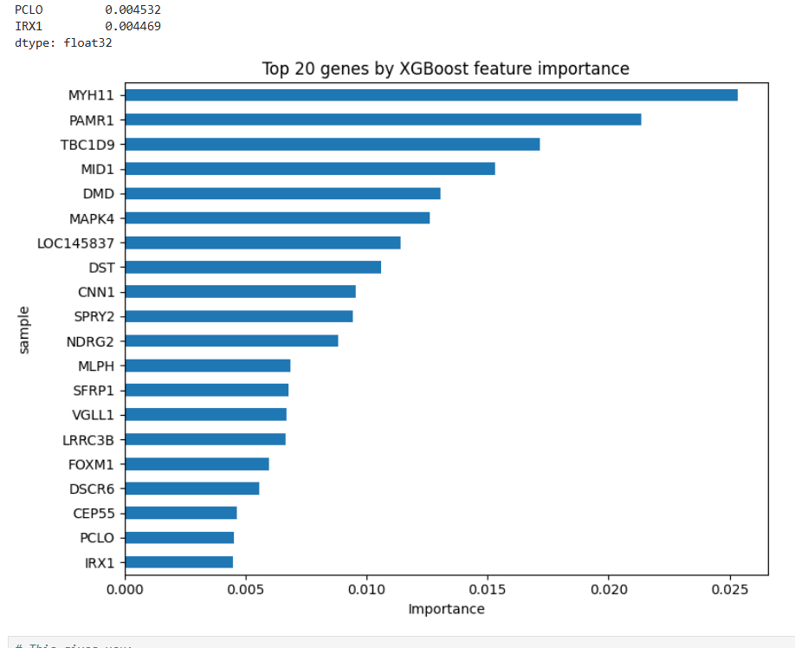
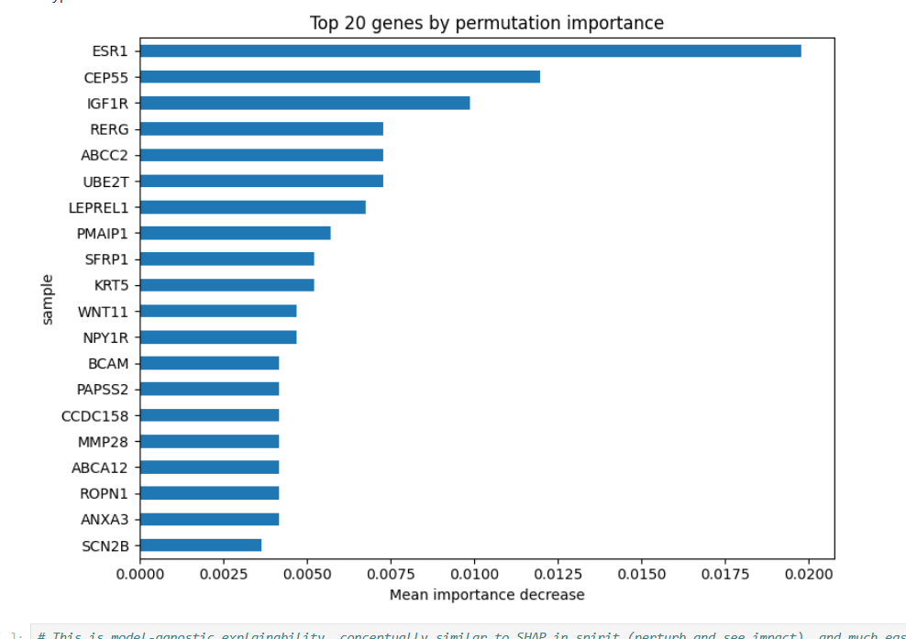
Visualization of top 20 genes

Slide 15
RAG based biological interpretation
Gene expression–based models often produce accurate predictions but lack biological context
Interpreting subtype predictions requires:
- Prior biological knowledge
Curated oncology literature
Goal: Ground model predictions in peer-reviewed biological knowledge using RAG
RAG work as a hybrid AI framework that retrieves relevant cancer biology literature and uses an LLM to generate context-aware explanations of model predictions

Slide 16
RAG Pipeline Architecture
Predicted PAM50 Subtype
Subtype-Specific Knowledge Base
(PAM50 biology, TCGA context, subtype literature)
Vector Embeddings (Sentence Transformers)
Semantic Retrieval (ChromaDB)
Biologically Grounded Explanation
LLM (Gemma via Ollama)

Slide 17
Knowledge sources used
How Retrieval Works
Text split into semantic chunks
Embedded using sentence-transformers
Stored in ChromaDB vector store
Top-k biologically relevant passages retrieved per query
This ensures:
Reduced hallucination
Explanations remain anchored to known biology
PAM50 subtype biology summaries
TCGA-BRCA dataset context
Subtype-specific transcriptional characteristics
Curated oncology text files

Slide 18
LLM-Assisted Interpretation
Impact in Computational Oncology
Gemma LLM (local, via Ollama) used for:
- Synthesizing retrieved biological context
- Explaining subtype predictions in clear scientific language
LLM does not generate facts independently
Acts as a reasoning and summarization layer
The LLM operates under retrieved biological constraints
Bridges machine learning outputs with biological interpretation
Supports:
- Hypothesis generation
- Biomarker contextualization
- Transparent AI-assisted decision support
Aligns with translational and explainable AI research goals
RAG enables biologically grounded, literature-aware explanations of cancer subtype predictions, transforming black-box outputs into interpretable scientific insights

Slide 19
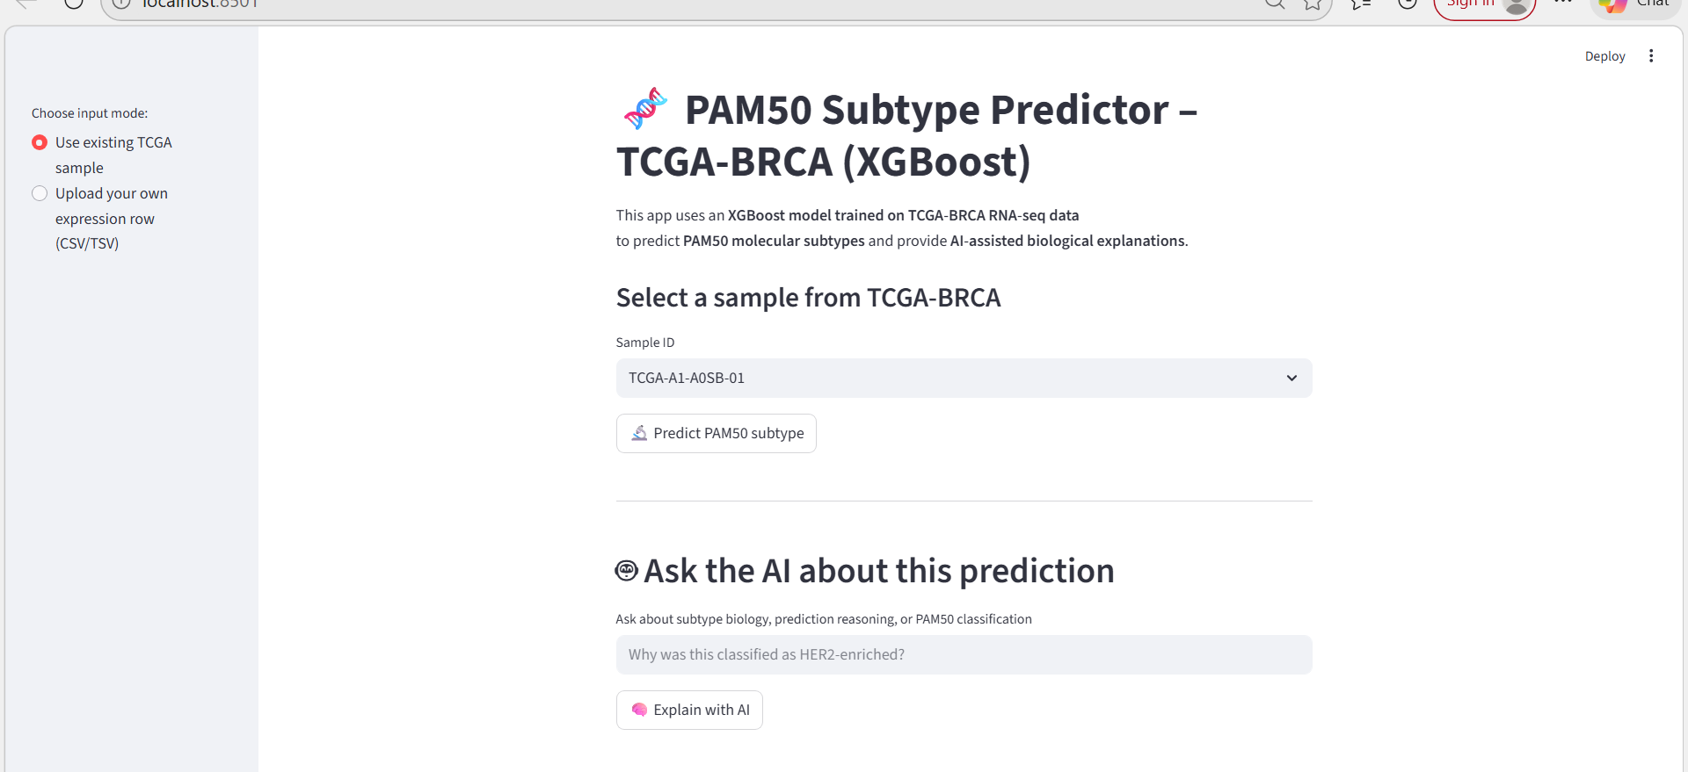
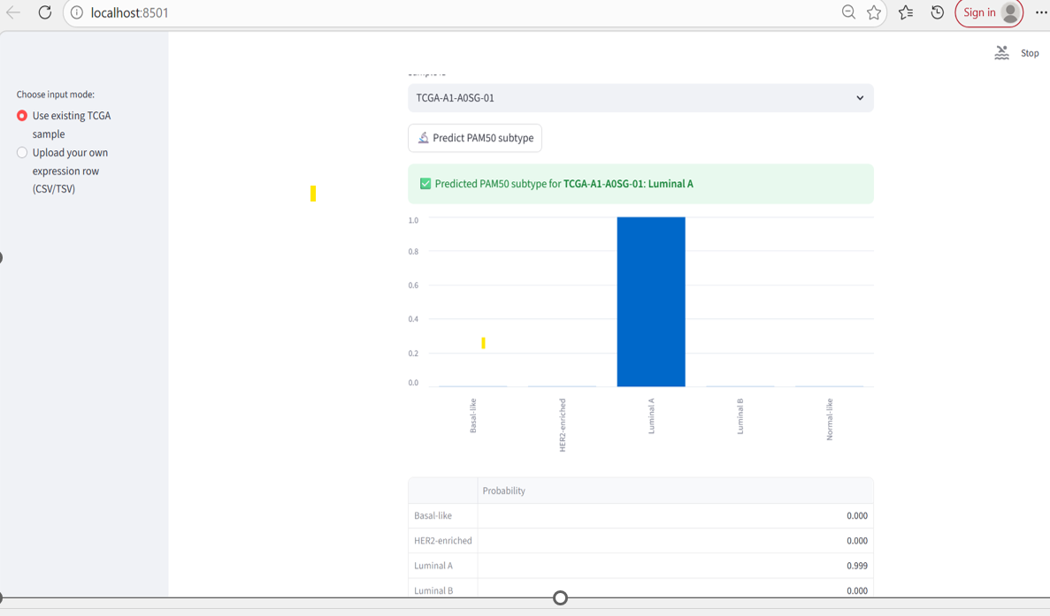
Deployment via streamlit

Slide 20
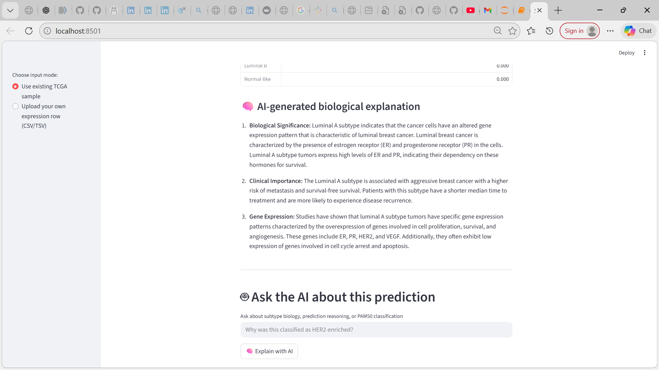
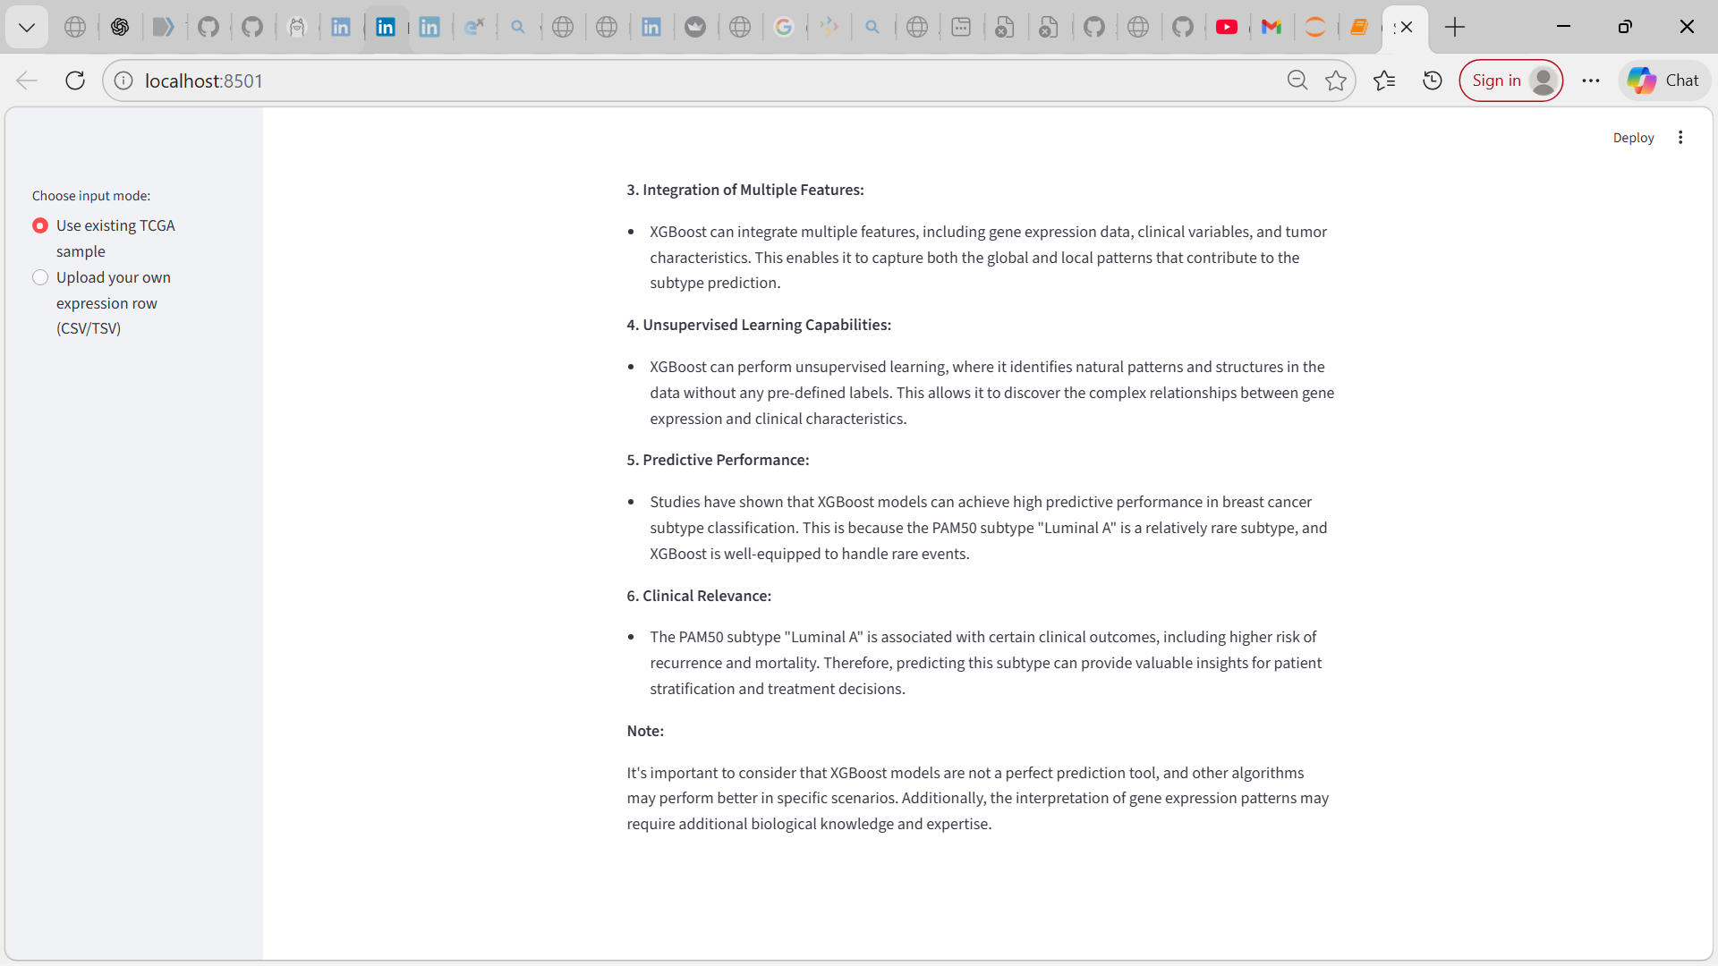
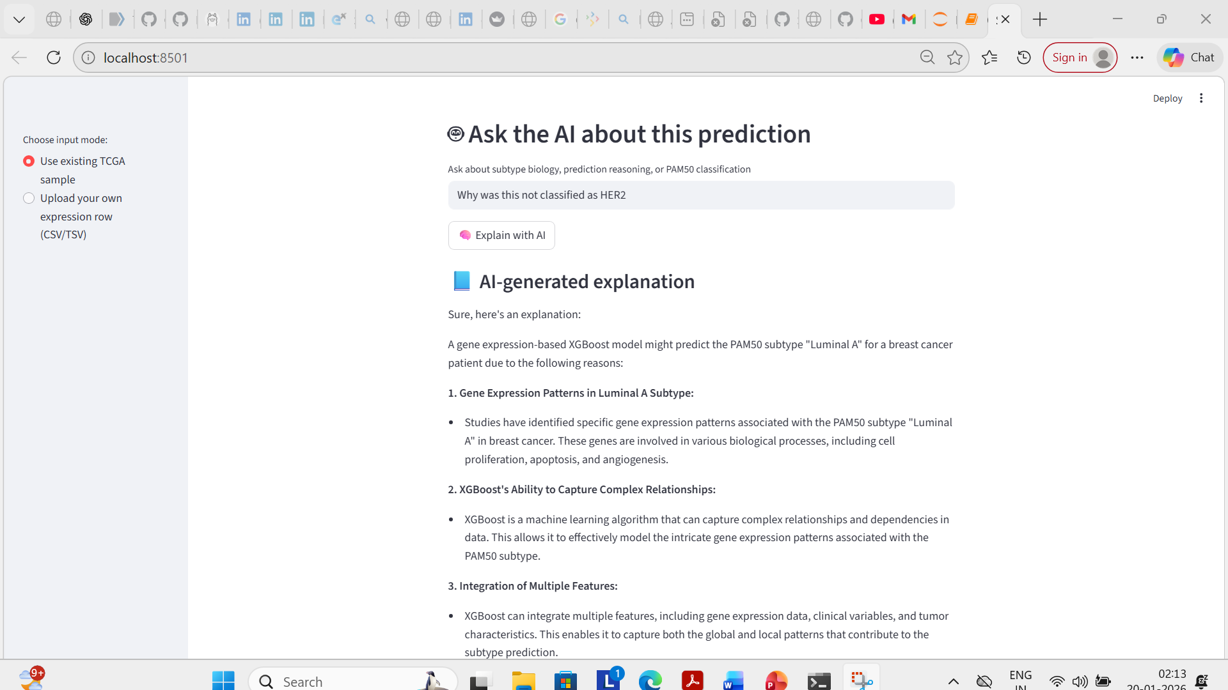
The system is designed for interpretability-first exploration, not clinical decision-making

Slide 21
Conversational AI Explanation Layer (Agent-Based, RAG-Powered)
Conversational layer / User Interaction layer:
This enables natural language interaction with model predictions
Allows users to ask:
-> “What does this subtype mean?”
->“Why was HER2-enriched predicted?”
-> “What genes/pathways are involved?”
Implemented based on:
Agent-based routing logic (lightweight, Python-based)
Query intent inferred via prompt-level reasoning
Each query routed to:
-> Subtype biology explanation
-> Prediction reasoning
-> General PAM50 knowledge

Slide 22
AI Backbone
- Retrieval-Augmented Generation (RAG)
-> Vector search over curated oncology text
-> Context passed to LLM (Gemma via Ollama)
- Responses are literature-grounded, not hallucinated
User Interface
- Integrated directly into Streamlit
- Interactive, real-time explanations alongside predictions
Designed for interpretability
Replaced classical NLU with a simpler, more transparent agent-based conversational layer grounded in retrieval and LLM reasoning. This reduced system complexity while maintaining interpretability and biological relevance

Slide 23
Challenges faced and solutions
Problem 1: SHAP-based explainability was initially planned but proved impractical
- The project was initially designed to use SHAP for gene-level attribution in the XGBoost PAM50 model
- In practice, SHAP introduced significant computational overhead, version conflicts, and instability with high-dimensional RNA-seq data
- Translating raw SHAP values into biologically meaningful explanations was non-trivial and risked superficial interpretation
Solution:
- Strategically deprioritized SHAP to avoid unstable or misleading explanations
- Instead, focused on:
- Model-level interpretability-
Robust subtype prediction using XGBoost global feature importance – which genes matter most overall
Permutation style importance to identify genes influencing subtype prediction overall
- Biology level interpretability
- Literature grounded interpretation using a Retrieval-Augmented Generation (RAG) framework
- Link model important genes to:
Curated oncology literature
PAM50 biology
LLM-assisted explanation grounded in known molecular mechanisms
- This shift emphasized biological plausibility and interpretive clarity over unstable feature attribution

Slide 24
Problem 2: Planned Rasa NLU–based chatbot added system complexity
- The project initially planned to include a Rasa NLU/Core–based conversational chatbot to explain subtype predictions
- Integrating Rasa introduced:
High configuration overhead (intents, domain, rules, policies)
Version and dependency conflicts on Windows
Tight coupling between dialogue management and scientific explanation
- This complexity did not directly improve the biological interpretability of model outputs
Solution:
- Intentionally replaced Rasa NLU with a lightweight agent-based conversational layer
- Instead of intent classification, the system uses:
Rule-based query routing
LLM-driven reasoning with RAG
- User questions are answered by:
Retrieving relevant oncology context (PAM50 biology, subtype characteristics)
Generating grounded explanations via an LLM
- This approach enabled flexible, domain-aware interaction without brittle dialogue rules
- Replaced heavyweight NLU with a simpler, more robust agent-based explanation interface

Slide 25
Problem 3: Library and dependency conflicts
- Frequent version conflicts (LangChain, ChromaDB, Pydantic, TensorFlow)
- Errors during environment setup and execution
Solution:
- Carefully aligned compatible library versions
- Isolated the project in a dedicated Conda environment
- Simplified the stack where possible
Problem 4: Vector database locking and persistence issues
- ChromaDB caused file locking and schema errors during development
- Difficulty deleting or reusing existing vector stores
Solution:
- Rebuilt the vector database cleanly
- Standardized the directory structure and persistence logic

Slide 26
Problem 5: Data path and file handling issues
- Errors due to incorrect file paths (processed data, parquet files)
- Differences between development and execution directories
Solution:
- Standardized folder structure
- Added explicit path handling and validation
Problem 6: Integrating ML output with the UI
- Passing predictions into the conversational explanation layer required careful state handling
Solution:
- Used Streamlit session state to store predictions
- Cleanly connected model output → explanation → user interaction

Slide 27
Summary
What was built?
An interpretable PAM50 breast cancer subtype prediction pipeline using TCGA BRCA RNA seq data
XGBoost based multi class classification with robust preprocessing and validation
RAG-powered biological interpretation layer to contextualize predictions using curated oncology literature
Interactive deployment via Streamlit with an agent based explanation interface

Slide 28
Why it matters?
Moves beyond black-box prediction towards biologically interpretable AI
Bridges ML outputs and cancer biology understanding
Enables transparent subtype reasoning relevant for biomarker discovery and hypothesis generation
Core take aways
- Explainability is essential for trust and usability in computational oncology
- Literature grounded AI (RAG) enhances interpretability without replacing biological expertise
- Interdisciplinary integration of ML, bioinformatics, and AI reasoning is key for precision medicine research

Slide 29
Impact
Provides a reusable framework for explainable cancer subtype modelling
This work demonstrates how explainable AI can translate high- dimensional transcriptomic data into biologically meaningful insight
This project also demonstrates readiness for PhD-level research in computational oncology by integrating machine learning, cancer biology, and explainable AI into a coherent, reproducible framework

Slide 30
Thank you

